Slide 1
Presentation
Sci-Fi Group Project
Margita Dekanyova
5.6.2023

Slide 2
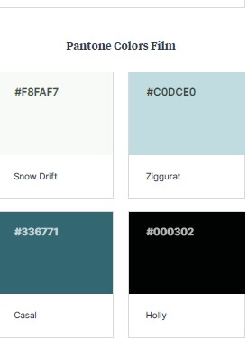
The task: Futuristic Spaceship Room with specified color scheme

Slide 3
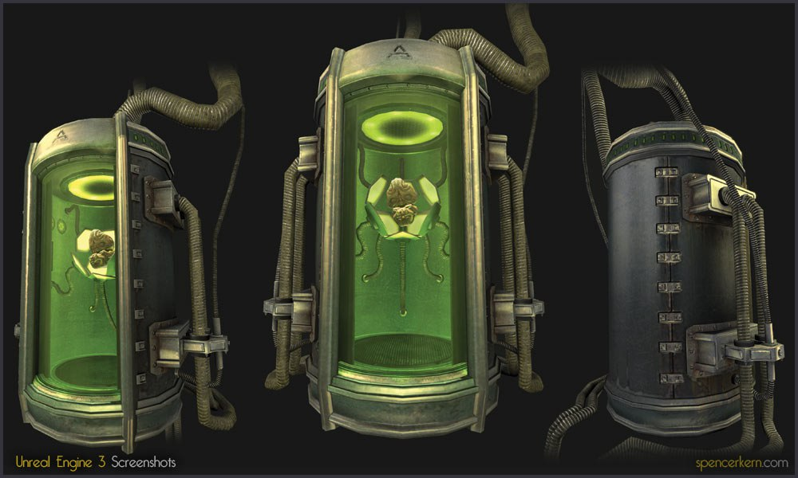
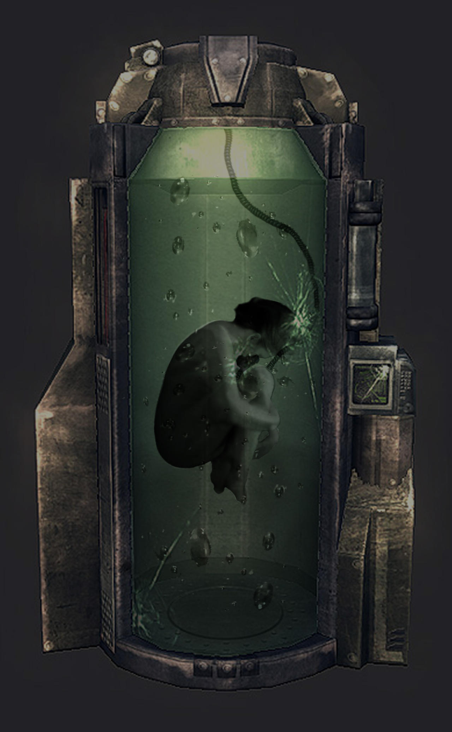
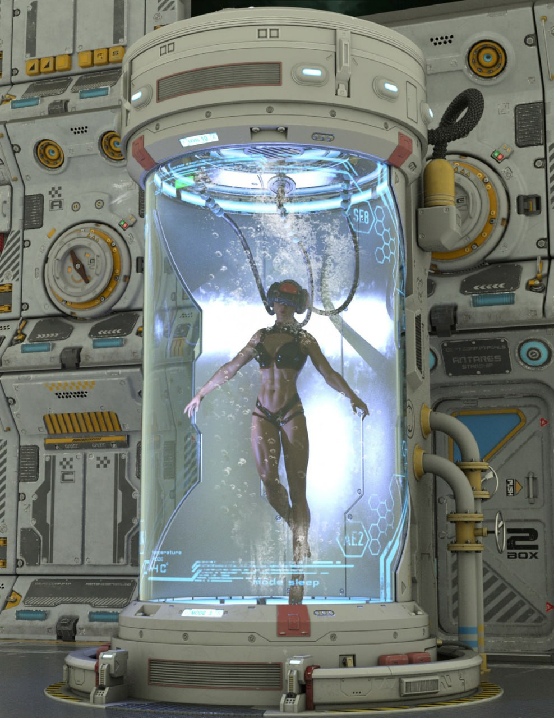
After a long search, I found this model, which meets the task and is a challenge for me. I chose this model because I can try doing many things such as fluid. modeling.
Human Test Tube

Slide 4
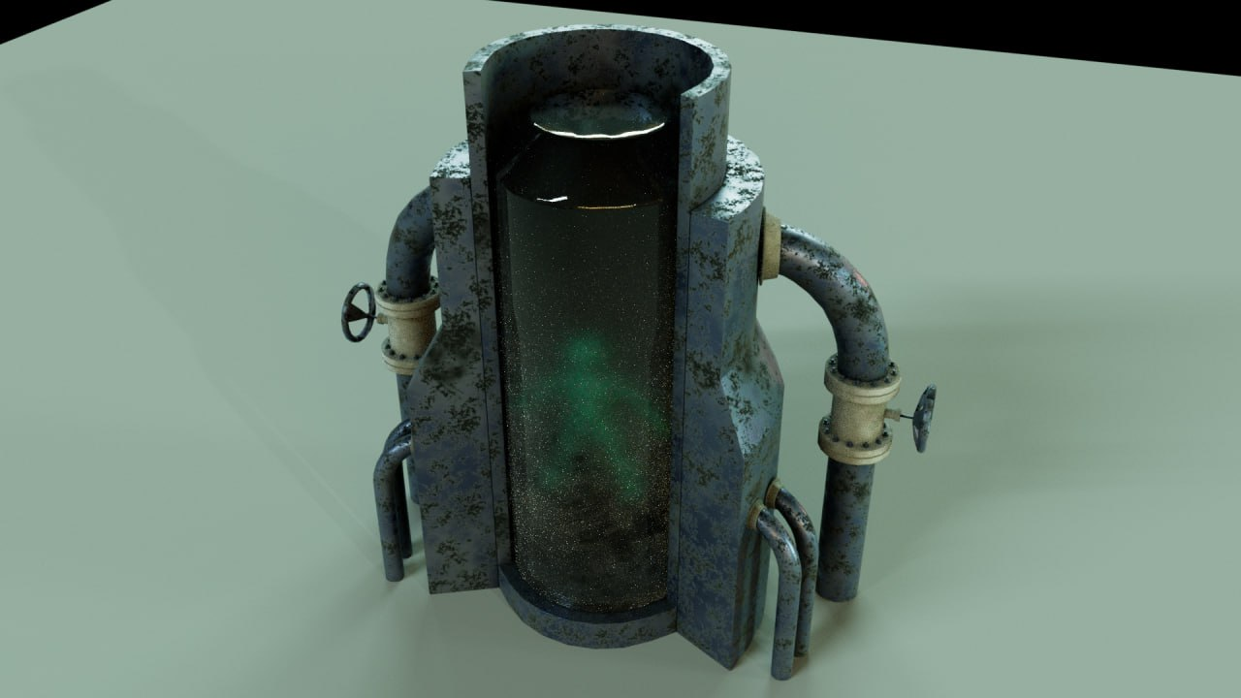
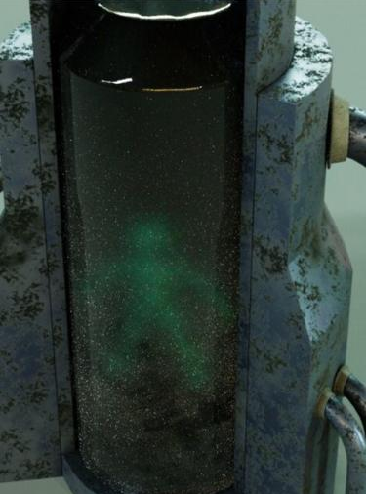
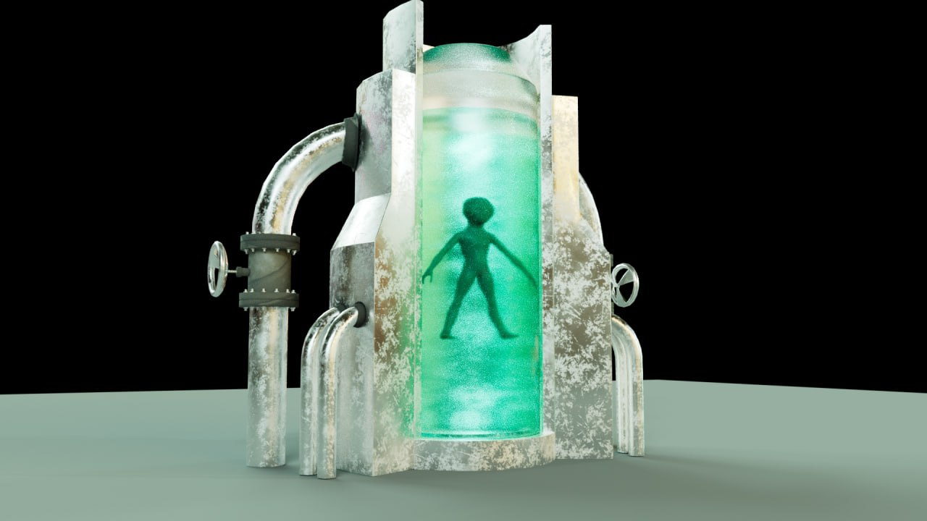
I left the creation of the color scheme to the end, taking into account the work of my group members and the color scheme given in the task.

Slide 5
Daniel asked me to make a shelf that could hold several tubes. So, I try to stay creative and create a model that fits our project.

